Slide 1
Control constructs in ‘c’ language

Slide 2
Introduction
C provides two styles of flow control:
Branching
Looping
Branching is deciding what actions to take and looping is deciding how many times to take a certain action.
Branching constructs:
if
if … else
if … else if … else (nested if … else)
Looping constructs:
while
do while
for
Loop control statements:
break
continue
goto

Slide 3
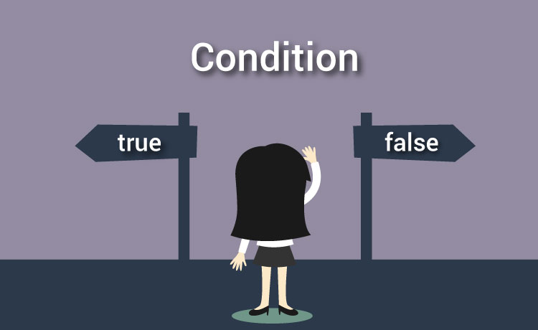
Branching

Slide 4
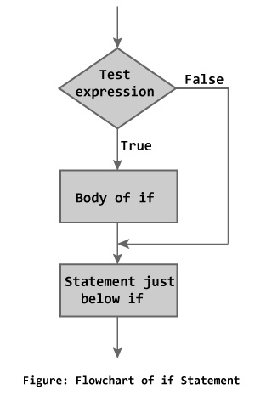
C if statement
The if statement evaluates the test expression inside parenthesis.
If test expression is evaluated to true (nonzero), statements inside the body of if is executed.
If test expression is evaluated to false (0), statements inside the body of if is skipped.
if (testExpression)
{
// statements
}

Slide 5
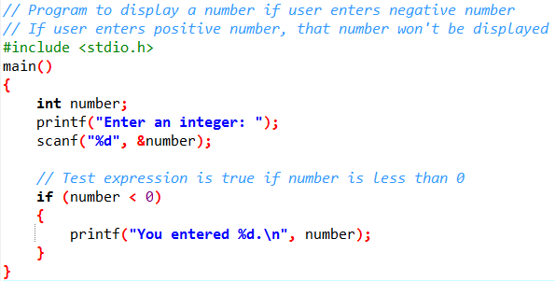
C if statement
When user enters -2, the test expression (number < 0) becomes true. Hence, You entered -2 is displayed on the screen.
When user enters 5, the test expression (number < 0) becomes false and the statement inside the body of if is skipped.

Slide 6
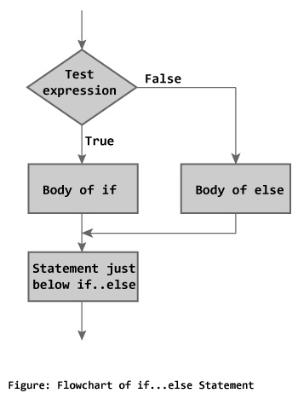
C if…else statement
The if...else statement executes some code if the test expression is true (nonzero) and some other code if the test expression is false (0).
If test expression is true, codes inside the body of if statement is executed and, codes inside the body of else statement is skipped.
If test expression is false, codes inside the body of else statement is executed and, codes inside the body of if statement is skipped.
if (testExpression) {
// codes inside the body of if
}
else {
// codes inside the body of else
}

Slide 7
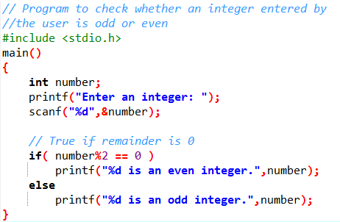


C if…else statement
When user enters 7, the test expression ( number%2 == 0 ) is evaluated to false. Hence, the statement inside the body of else statement printf("%d is an odd integer"); is executed and the statement inside the body of if is skipped.

Slide 8
C if…else if…else statement (nested if…else)
The if...else statement executes two different codes depending upon whether the test expression is true or false. Sometimes, a choice has to be made from more than 2 possibilities.
The nested if...else statement allows you to check for multiple test expressions and execute different codes for more than two conditions.
if (testExpression1)
{
// statements to be executed if testExpression1 is true
}
else if(testExpression2)
{
// statements to be executed if testExpression1 is false and testExpression2 is true
}
else if (testExpression 3)
{
// statements to be executed if testExpression1 and testExpression2 is false and testExpression3 is true
}
.
.
else
{
// statements to be executed if all test expressions are false
}

Slide 9
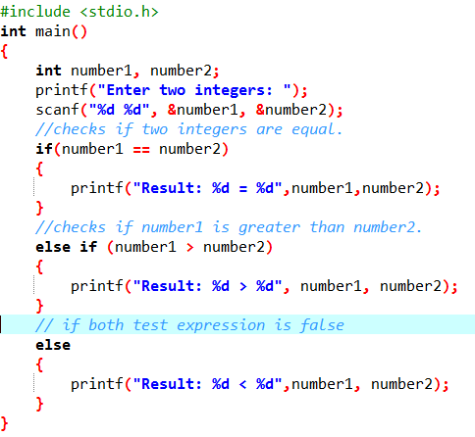
C if…else if…else statement (nested if…else)

Slide 10
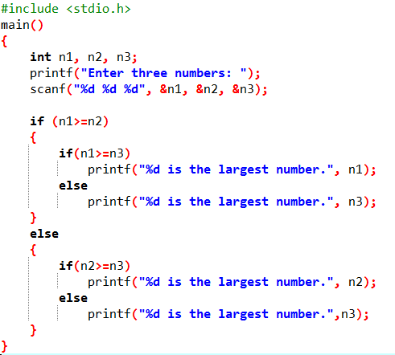
C if…else if…else statement (nested if…else)

Slide 11
Ternary operator vs. if … else statement
The ? : operator is just like an if ... else statement.
? : is a ternary operator in that it takes three values.
? : takes the following form:
if condition is true ? then X return value : else Y value;

Slide 12

C switch … case statement

Slide 13
C switch … case statement
switch (variable or constant)
​{
case constant1:
// code to be executed if n is equal to constant1;
break;
case constant2:
// code to be executed if n is equal to constant2;
break;
.
.
.
default:
// code to be executed if n doesn't match any constant
}
The nested if...else statement allows you to execute a block code among many alternatives. If you are checking on the value of a single variable in nested if...else statement, it is better to use switch statement.
The switch statement is often faster than nested if...else.

Slide 14
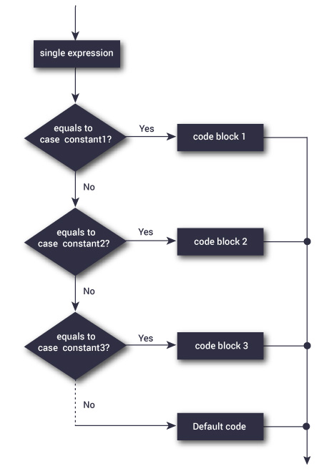
C switch … case statement
When a case constant is found that matches the switch expression, control of the program passes to the block of code associated with that case.
In the above pseudocode, suppose the value of n is equal to constant2. The compiler will execute the block of code associate with the case statement until the end of switch block, or until the break statement is encountered.
The break statement is used to prevent the code running into the next case.
If break statement is not used, all cases after the correct case is executed.

Slide 15
C switch … case statement
Few points to remember:
Switch condition accepts integer as well as character type of variables or values.
Case values should always be a constant.
Case doesn’t always need to have order 1, 2, 3 and so on. It can have any integer value after case keyword. Also, case doesn’t need to be in an ascending order always, you can specify them in any order as per the need of the program.
The expression provided in the switch should result in a constant value otherwise it would not be valid.
switch(1+2+23), switch(1*2+3%4), switch(a+b+c) are all valid.
Nesting of switch statements are allowed, which means you can have switch statements inside another switch. However nested switch statements should be avoided as it makes program more complex and less readable.
switch-case do not execute any statements outside these blocks case and default

Slide 16
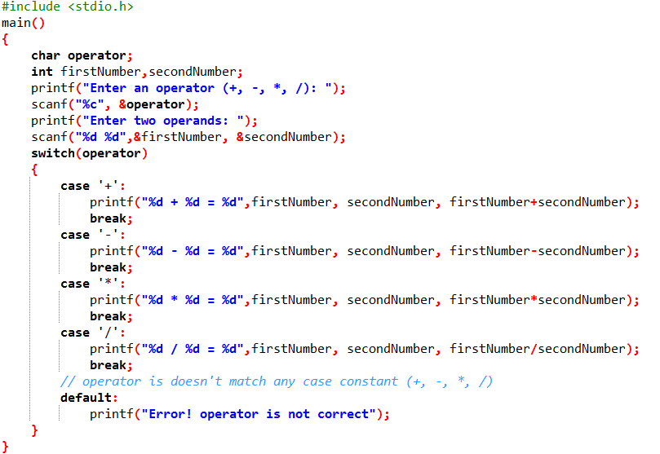

C switch … case statement

Slide 17

Looping

Slide 18
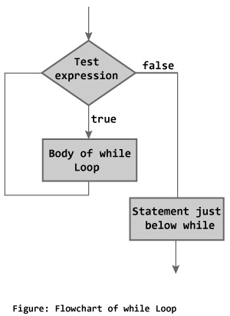
while loop
The syntax of a while loop is:
while (testExpression)
{
//codes
}
where, testExpression checks the condition is true or false before each loop.
The while loop evaluates the test expression.
If the test expression is true (nonzero), codes inside the body of while loop is evaluated. The test expression is evaluated again. The process goes on until the test expression is false.
When the test expression is false, the while loop is terminated.

Slide 19
Counter Controlled Loops
The type of loops, where the number of the execution is known in advance are termed by the counter controlled loop.
That means, in this case, the value of the variable which controls the execution of the loop is previously known.
The control variable is known as counter.
A counter controlled loop is also called definite repetition loop.
while loop is a counter controlled loop.

Slide 20
Entry Controlled Loops
The types of loop where the test condition is stated before the body of the loop, are known as the entry controlled loop.
So in the case of an entry controlled loop, the condition is tested before the execution of the loop.
If the test condition is true, then the loop gets the execution, otherwise not.
For example, the while loop is an entry controlled loop.

Slide 21
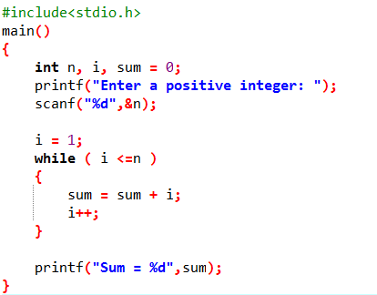
while loop

Slide 22
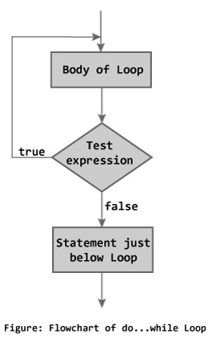
do while loop
The do while loop is similar to the while loop with one important difference. The body of do...while loop is executed once, before checking the test expression. Hence, the do while loop is executed at least once.
do
{
// codes
} while (testExpression);
The code block (loop body) inside the braces is executed once.
Then, the test expression is evaluated. If the test expression is true, the loop body is executed again. This process goes on until the test expression is evaluated to 0 (false).
When the test expression is false (nonzero), the do...while loop is terminated.

Slide 23
Sentinel Controlled Loops
The type of loop where the number of execution of the loop is unknown, is termed by sentinel controlled loop.
In this case, the value of the control variable differs within a limitation and the execution can be terminated at any moment as the value of the variable is not controlled by the loop.
The control variable in this case is termed by sentinel variable.
do while is a sentinel controlled loop.

Slide 24
Exit Controlled Loops
The types of loop where the test condition is stated at the end of the body of the loop, are know as the exit controlled loops.
So, in the case of the exit controlled loops, the body of the loop gets execution without testing the given condition for the first time. Then the condition is tested.
If it comes true, then the loop gets another execution and continues till the result of the test condition is not false.
For example, the do statement or the do....while loop is an exit controlled loop.

Slide 25
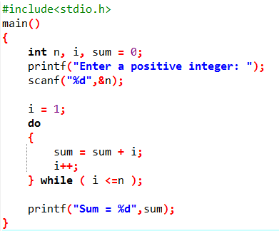
do while loop

Slide 26
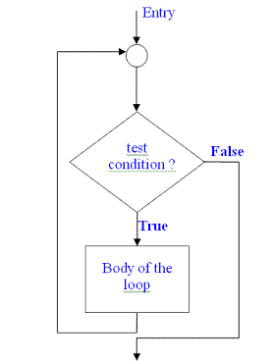
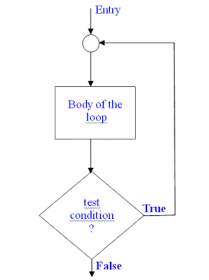
No. | Topics | Entry controlled loops | Exit controlled loops
01 | Test condition | Test condition appears at the beginning. | Test condition appears at the end.
02 | Control variable | Control variable is counter variable. | Control variable is counter & sentinel variable.
03 | Execution | Each execution occurs by testing condition. | Each execution except the first one occurs by testing condition.
04 | Type of loop | while and for loop | do while loop
05 | Examples | = = = = = = = = sum = 0; n = 1; while (n <= 10) { sum = sum + n*n; n = n+ 1; } = = = = = = = = | = = = = = = do { printf(“Input a number.\n”); scanf("%d", &num); } while(num>0); = = = = = =
06 | Flowchart

Slide 27
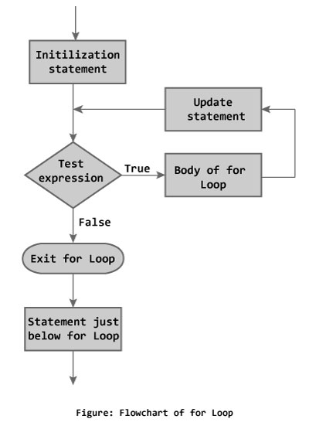
for loop
for (initializationStatement; testExpression; updateStatement)
{
// codes
}
The initialization statement is executed only once.
Then, the test expression is evaluated. If the test expression is false (0), for loop is terminated. But if the test expression is true (nonzero), codes inside the body of for loop is executed and the update expression is updated.
This process repeats until the test expression is false.
The for loop is commonly used when the number of iterations is known.

Slide 28
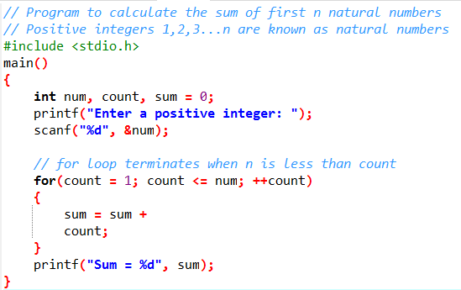
for loop

Slide 29
Various forms of for loop
1) Here instead of num++, I’m using num=num+1 which is nothing but same as num++.
for (num=10; num<20; num=num+1)
2) Initialization part can be skipped from loop as shown below, the counter variable is declared before the loop itself.
int num=10;
for (;num<20;num++)
Must Note: Although we can skip initialization part but semicolon (;) before condition is must, without which you will get compilation error.

Slide 30
Various forms of for loop
3) Like initialization, you can also skip the increment part as we did below. In this case semicolon (;) is must, after condition logic. The increment part is being done in for loop body itself.
for (num=10; num<20; )
{
//Code
num++;
}

Slide 31
Various forms of for loop
4) Below case is also possible, increment in body and initialization during declaration of counter variable.
int num=10;
for (;num<20;)
{
//Statements
num++;
}

Slide 32
Various forms of for loop
5) Counter can be decremented also, In the below example the variable gets decremented each time the loop runs until the condition num>10 becomes false.
for(num=20; num>10; num--)
6) Infinite loop
for(; ;) { }
A loop becomes an infinite loop if a condition never becomes false. When the conditional expression is absent, it is assumed to be true. You may have an initialization and increment expression.
while(1) { } → also a kind of infinite loop.
In while and do while, if increment/decrement operation is missing, then also, it’s an infinite loop.
Can use break statement to terminate an infinite loop.

Slide 33
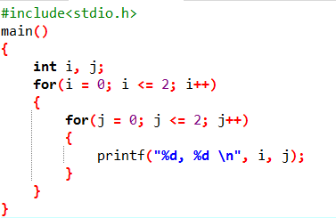
Nested for loop

Slide 34
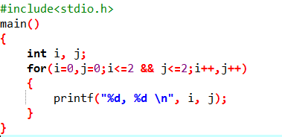
Multiple initializations in for loop

Slide 35
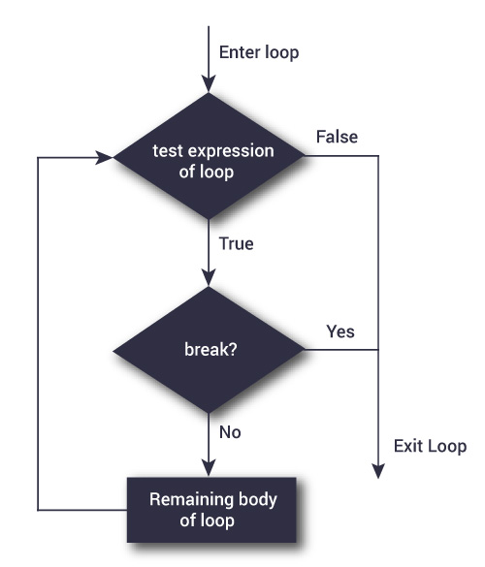
break statement
It is sometimes desirable to skip some statements inside the loop or terminate the loop immediately without checking the test expression.
In such cases, break and continue statements are used.
The break statement terminates the loop (for, while and do...while loop) immediately when it is encountered. The break statement is used with decision making statement such as if...else.
break statement is also used with switch...case statement.
Syntax of break statement
break;

Slide 36
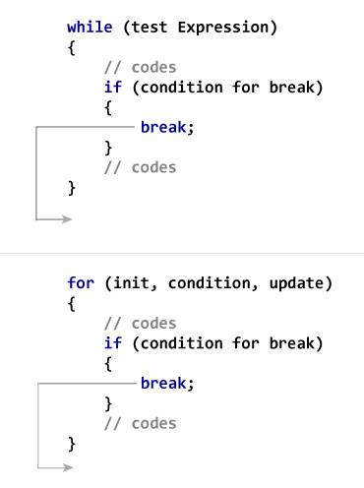
break statement

Slide 37
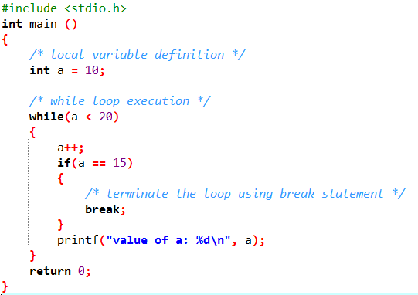
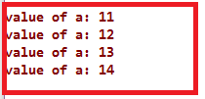
break statement
Variable a value keeps on getting incremented and when it reaches 15, if condition gets satisfied and break statement would get executed. This leads to termination of while loop and hence value of a will get printed only till 14.

Slide 38
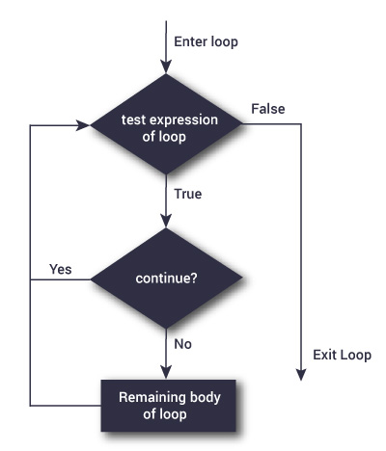
continue statement
The continue statement skips some statements inside the loop. The continue statement is used with decision making statement such as if...else.
Syntax of continue statement
continue;

Slide 39
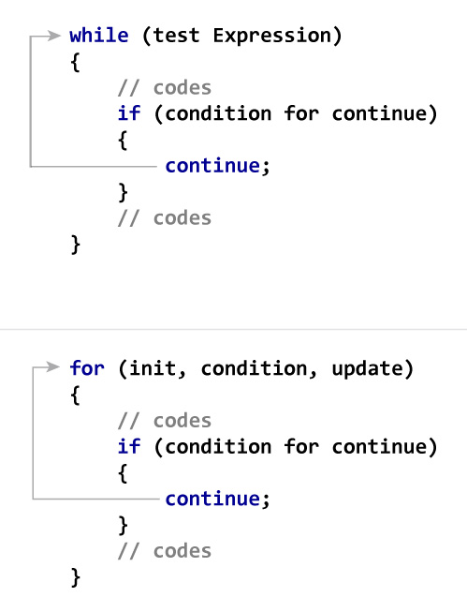
continue statement

Slide 40
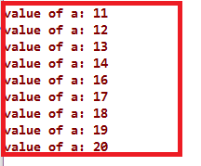
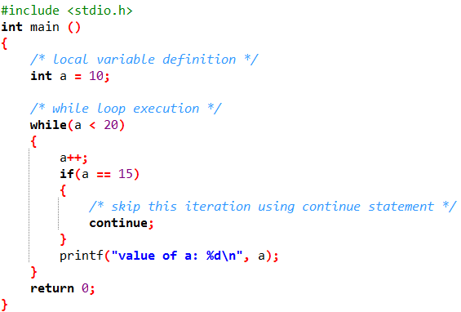
continue statement
Why value 15 is missing in output?
Variable a value keeps on getting incremented and when it reaches 15, if condition gets satisfied and continue statement would get executed. This leads to skipping of the current iteration when value of a is 15, and while loop is again executed with next value of a which is 16.

Slide 41
break vs. continue statement
break | continue
A break can appear in both switch and loop (for, while, do) statements. | A continue can appear only in loop (for, while, do) statements.
A break causes the switch or loop statements to terminate the moment it is executed. Loop or switch ends abruptly when break is encountered. | A continue doesn't terminate the loop, it causes the loop to go to the next iteration. All iterations of the loop are executed even if continue is encountered. The continue statement is used to skip statements in the loop that appear after the continue.
When a break statement is encountered, it terminates the block and gets the control out of the switch or loop. | When a continue statement is encountered, it gets the control to the next iteration of the loop.
A break causes the innermost enclosing loop or switch to be exited immediately. | A continue inside a loop nested within a switch causes the next loop iteration.

Slide 42

goto statement

Slide 43
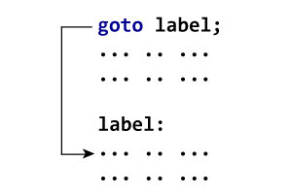
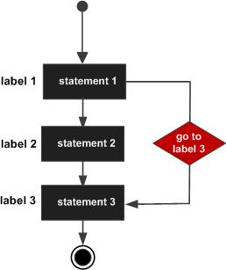
goto statement
The goto statement is used to alter the normal sequence of a C program.
The label is an identifier. When goto statement is encountered, control of the program jumps to label: and starts executing the code.
Syntax of goto statement
goto label;
... .. ...
... .. ...
... .. ...
label:
statement;

Slide 44
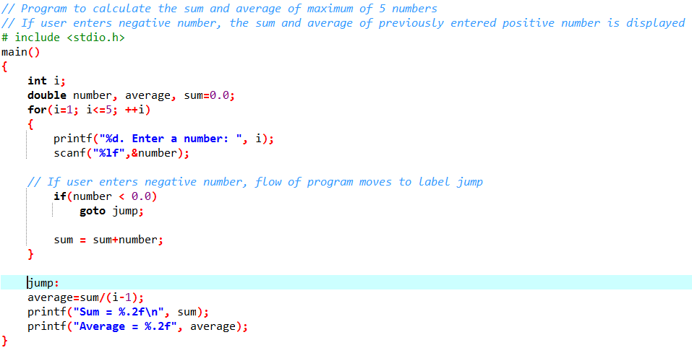
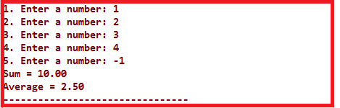
goto statement

Slide 45
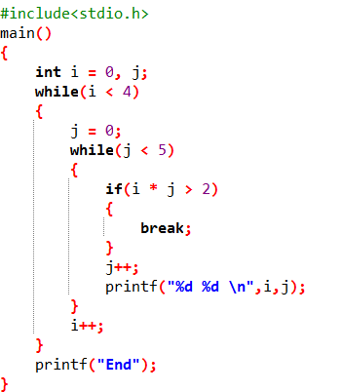
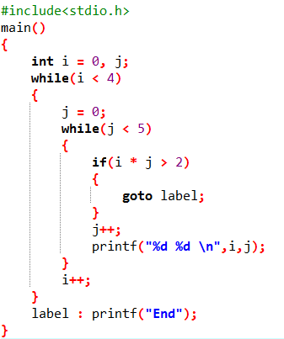
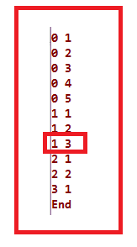
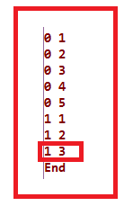
About goto statement
goto statement allows you to do bad stuff such as jump out of scope.
goto statement can be useful sometimes. For example: to break from nested loops.

Slide 46
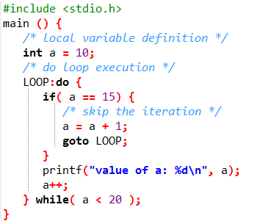
About goto statement
Can be used as another form of continue as well.

Slide 47
Thank you
ANY QUESTIONS???

